Slide 1
Dynamically Creating PDF files
Sean C. Sullivan
sean <at> seansullivan <dot> com
May 2003

Slide 2

What is PDF?
Portable Document Format

Slide 3
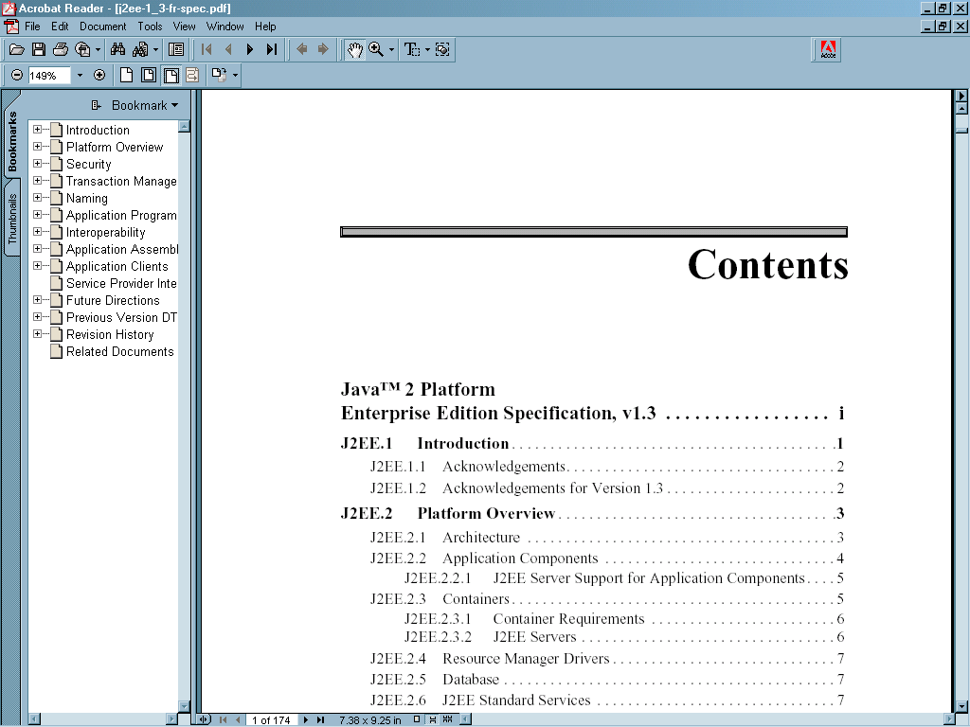
Adobe Acrobat Reader

Slide 4
PDF documents
Text
Lists
Tables
Images
Headers
Footers

Slide 5
PDF features
Multi-lingual font support
Page sizes and layouts
Searchable
Embedded hyperlinks
Electronic forms (FDF)
Encryption

Slide 6

iText class library
http://www.lowagie.com/iText/

Slide 7
iText features
create PDF, FDF, or RTF files
document templates
hyphenation
JPEG, GIF and PNG images
PDF encryption
headers, footers
automatic page numbering

Slide 8
HelloiText application
import com.lowagie.text.*;
import com.lowagie.text.pdf.*;
import java.io.*;
public class HelloiText
{
public static void main(String[] args)
throws IOException, DocumentException
{
OutputStream os = new FileOutputStream(
"helloitext.pdf");
Document doc = new Document();
PdfWriter docWriter = null;

Slide 9
HelloiText application (cont.)
docWriter = PdfWriter.getInstance(doc, os);
doc.open();
Paragraph p;
p = new Paragraph("Hello iText");
doc.add(p);
doc.close();
os.close();
}
}

Slide 10
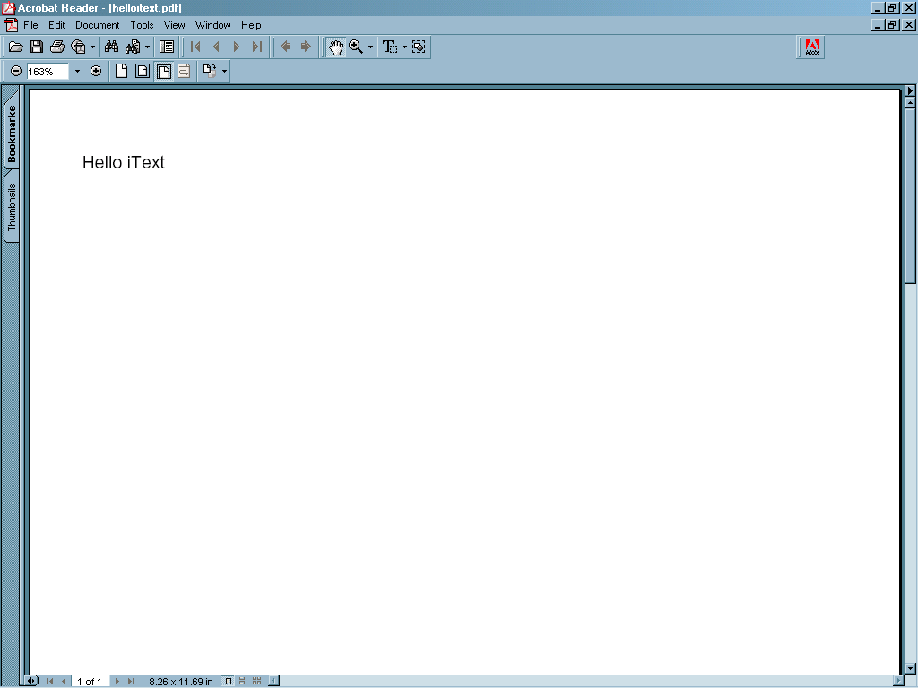
Output from HelloiText

Slide 11
iText packages
com.lowagie.text
com.lowagie.text.pdf
com.lowagie.text.rtf
com.lowagie.text.html
com.lowagie.text.xml

Slide 12
iText API
com.lowagie.text.Document
com.lowagie.text.pdf.PdfWriter
com.lowagie.text.Paragraph
com.lowagie.text.Phrase
com.lowagie.text.HeaderFooter
com.lowagie.text.Image
com.lowagie.text.Table

Slide 13
iText API example
OutputStream os = new ByteArrayOutputStream();
Document doc = new Document();
PdfWriter pw = PdfWriter.getInstance(doc, os);
doc.open();
Image img = Image.getInstance(filename);
doc.add(img);
Table t = new Table(2);
t.addCell(new Cell(“San Diego”));
t.addCell(new Cell(“California”));
doc.add(t);

Slide 14
Server-side PDF creation
Web server
Web
browser
HTTP request
Servlet engine
HTTP response
Servlet

Slide 15
Implementation strategies for web applications
1) Create the PDF file on the server’s filesystem. The user downloads the file via HTTP GET
OR
2) Create the PDF file in memory. Send the document to the client via the ServletOutputStream
Notes:
First option: use java.io.FileOutputStream
Second option: use java.io.ByteArrayOutputStream

Slide 16
Using iText on the server
Create the document using the iText API and a ByteArrayOutputStream
Set HTTP response headers
Get ServletOutputStream object
Write document bytes to the ServletOutputStream
Flush the ServletOutputStream

Slide 17
HTTP response headers
Content type
Content length
Content-disposition
Cache headers (optional)

Slide 18
Content type
HttpServletResponse resp;
…
resp.setContentType(
“application/pdf”);
…
Notes:
Use either “attachment” or “inline”

Slide 19
Content length
HttpServletResponse resp;
…
resp.setContentLength(iFileLength);
…
Notes:
Use either “attachment” or “inline”

Slide 20
Content-disposition
HttpServletResponse resp;
…
// either “inline” or “attachment”
resp.setHeader(
“Content-disposition”,
“attachment; filename=foobar.pdf”);
Notes:
Use either “attachment” or “inline”

Slide 21
HTTP response cache headers
HttpServletResponse resp;
…
// read HTTP 1.1 spec for
// more info
resp.setHeader(
"Cache-control",
"must-revalidate");

Slide 22
Using the servlet’s output stream
HttpServletResponse resp;
…
ServletOutputStream sos;
sos = resp.getOutputStream();
sos.write( … );
sos.flush();
…

Slide 23
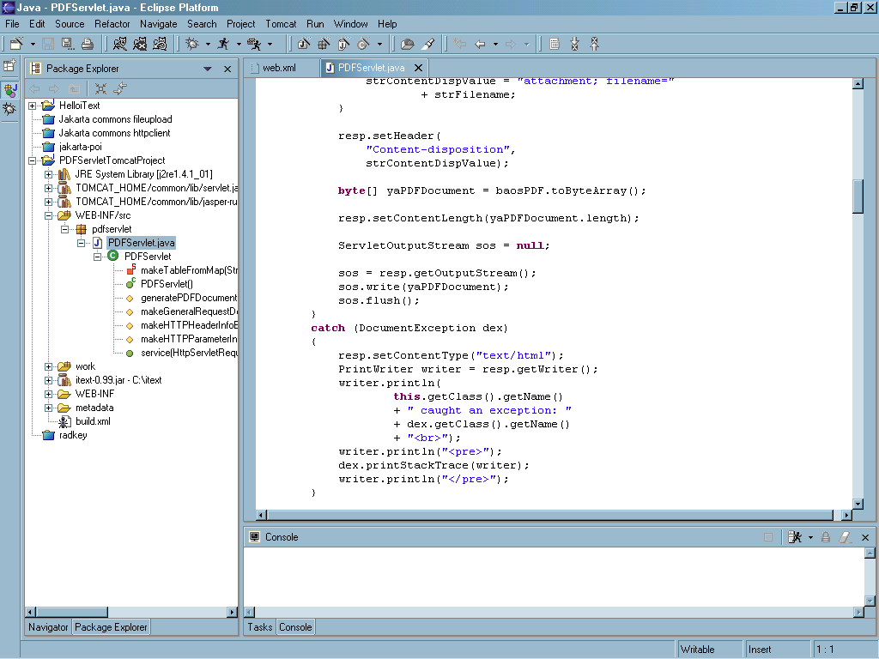
Demo

Slide 24
Open source projects
http://www.lowagie.com/iText
http://xml.apache.org/fop/
http://www.jpedal.org/
http://www.pdfbox.org/
http://jasperreports.sourceforge.net/
http://sourceforge.net/projects/itextsharp/
http://sourceforge.net/projects/itextdotnet/

Slide 25
Additional resources
http://www.adobe.com/
http://www.planetpdf.com/
http://www.pdfzone.com/

Slide 26
Summary
use iText to create PDF documents
download iText today

